Slide 1

Comp 401 Graph vs. Dag vs. Tree Object Structures
Instructor: Prasun Dewan

Slide 2
Prerequisite
Composite Object Shapes

Slide 3
Cartesian Plane Alternatives
public interface CartesianPlane {
public int getAxesLength();
public void setAxesLength(int anAxesLength);
public Line getXAxis();
public Line getYAxis();
public StringShape getXLabel();
public StringShape getYLabel();
}
public interface DAGCartesianPlane {
public LineWithObjectProperty getXAxis();
public LineWithObjectProperty getYAxis();
public Point getXAxisLocation();
public Point getYAxisLocation();
public int getAxesLength();
public void setAxesLength(int anAxesLength);
public StringShape getXLabel();
public StringShape getYLabel();
}

Slide 4
DAG Cartesian Plane
public class ADAGCartesianPlane implements DAGCartesianPlane {
int originX, originY;
int axesLength;
LineWithObjectProperty xAxis, yAxis;
Point xAxisLocation, yAxisLocation;
StringShape xLabel;
StringShape yLabel;
public ADAGCartesianPlane(int theAxesLength,
int theOriginX, int theOriginY) {
axesLength = theAxesLength;
originX = theOriginX;
originY = theOriginY;
xAxisLocation = toXAxisLocation();
yAxisLocation = toYAxisLocation();
xAxis = new ALineWithObjectProperty
(xAxisLocation, theAxesLength, 0);
yAxis = new ALineWithObjectProperty
(yAxisLocation, 0, theAxesLength);
xLabel = new AStringShape("X", toXLabelX(), toXLabelY());
yLabel = new AStringShape("Y", toYLabelX(), toYLabelY());
}
Address copied, not object

Slide 5
DAG Cartesian Plane
public LineWithObjectProperty getXAxis() {return xAxis;
public LineWithObjectProperty getYAxis() {return yAxis;}
public Point getXAxisLocation() {return xAxisLocation;}
public Point getYAxisLocation() {return yAxisLocation;}
public void setAxesLength(int anAxesLength) {
axesLength = anAxesLength;
xAxis.setWidth(axesLength);
yAxis.setHeight(axesLength);
xAxisLocation = toXAxisLocation();
yAxisLocation = toYAxisLocation();
xAxis.setLocation(xAxisLocation );
yAxis.setLocation(yAxisLocation );
xLabel.setX(toXLabelX());
xLabel.setY(toXLabelY());
yLabel.setX(toYLabelX());
yLabel.setY(toYLabelY());
}
Point toXAxisLocation() {
return new ACartesianPoint(toXAxisX(), toXAxisY());
}
Point toYAxisLocation() {
return new ACartesianPoint(toYAxisX(), toYAxisY());
}
Address copied, not object

Slide 6
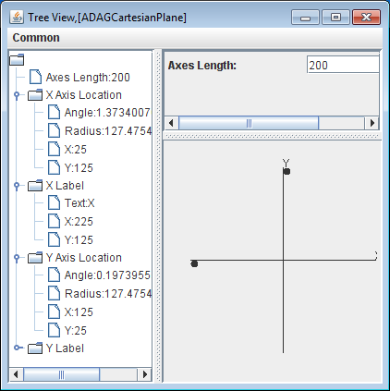
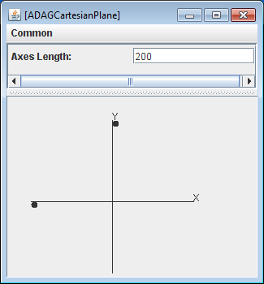
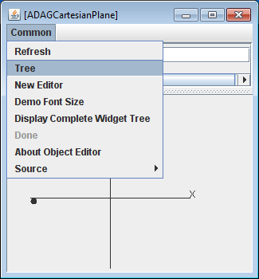


Displaying New Cartesian Plane
public interface DAGCartesianPlane {
public LineWithObjectProperty getXAxis();
public LineWithObjectProperty getYAxis();
public Point getXAxisLocation();
public Point getYAxisLocation();
public int getAxesLength();
public void setAxesLength(int anAxesLength);
public StringShape getXLabel();
public StringShape getYLabel();
}
X and Y axes not shown in Tree View

Slide 7
(Part of) DAG Logical Structure
DAGCartesianPlane
XAxis
YAxis
LineWith ObjectProperty
LineWith ObjectProperty
XAxisLocation
YAxisLocation
Height
Location
Location
Width
Width
Height
int
int
Point
Point
int
int
Can have multiple Paths to an Object (Node) but no cycles

Slide 8
Graph
DAGCartesianPlane
XAxis
YAxis
Parent
Parent
LineWith ObjectProperty
LineWith ObjectProperty
XAxisLocation
YAxisLocation
Height
Location
Location
Width
Width
Height
int
int
Point
Point
int
int
Returning back to a node: cycle

Slide 9
Tree
CartesianPlane
XAxis
YAxis
LineWith ObjectProperty
LineWith ObjectProperty
Height
Y
X
Width
Width
Height
int
int
int
int
Point
int
int
Single Path to an Object (Node)

Slide 10
Types of Structures
Tree
Each node has a single incoming edge
Cannot have multiple paths to a node
Each internal node roots a subtree in which no node has an edge to a node in any other subtree
Directed Acyclic Graph (DAG)
Can have multiple incoming edges to a node
But cannot return back to a node when one follows edges
Graph
A node can have multiple incoming edges to a node and thus can have multiple paths to a node
Can have cycles

Slide 11
Object Editor and Structures
ObjectEditor does not display certain non-tree logical structures
How to display them textually?
Performance and implementation reasons.
Neither does Swing or AWT
What if we have a non tree logical structure?

Slide 12
Two Problems
public interface DAGCartesianPlane {
public LineWithObjectProperty getXAxis();
public LineWithObjectProperty getYAxis();
public Point getXAxisLocation();
public Point getYAxisLocation();
public int getAxesLength();
public void setAxesLength(int anAxesLength);
public StringShape getXLabel();
public StringShape getYLabel();
}
Cannot see X and Y axis
See X and Y points

Slide 13
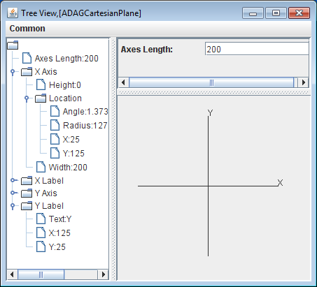
Making Display Structure a Tree
public class ADAGCartesianPlane implements DAGCartesianPlane {
@Visible(false)
public Point getXAxisLocation() {
return xAxisLocation;
}
@Visible(false)
public Point getYAxisLocation() {
return yAxisLocation;
}
…
}
To remove P from the displayed structure add annotation @Visible(false) to its getter
Tree Root
SubTree Root

Slide 14
(Part of) Tree Logical Display Structure
DAGCartesianPlane
Tree Root
XAxis
YAxis
LineWith ObjectProperty
LineWith ObjectProperty
SubTree Root
Height
Width
Height
Width
int
int
int
int

Slide 15
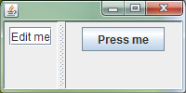
User Interface Structures
User interfaces are also structures; they consist of objects called windows or widgets or (UI) components
Root objects:
JFrame, Frame(top level window)
Leaf level objects:
JButton
JTextField,
Composite internal nodes:
JPanel – contains other UI components
JSplitPane – divides parent composite into two units with adjustable boundary

Slide 16
Window Tree Creator
public static JFrame createTree {
JFrame frame = new JFrame();
JSplitPane splitPane = new JSplitPane();
frame.add(splitPane);
JPanel leftPanel = new JPanel();
JPanel rightPanel = new JPanel();
splitPane.setLeftComponent(leftPanel);
splitPane.setRightComponent(rightPanel);
JTextField textField = new JTextField("Edit me");
leftPanel.add(textField);
JButton button = new JButton ("Press me");
rightPanel.add(button);
frame.setSize(200, 100);
frame.setVisible(true);
return frame;
}
JPanel
JTextField
JFrame
JSplitPane
JPanel
JButton

Slide 17
(Part of) DAG Logical Structure (Review)
DAGCartesianPlane
XAxis
YAxis
LineWith ObjectProperty
LineWith ObjectProperty
XAxisLocation
YAxisLocation
Height
Location
Location
Width
Width
Height
int
int
Point
Point
int
int
Can have multiple Paths to an Object (Node) but no cycles

Slide 18
Graph (Review)
DAGCartesianPlane
XAxis
YAxis
Parent
Parent
LineWith ObjectProperty
LineWith ObjectProperty
XAxisLocation
YAxisLocation
Height
Location
Location
Width
Width
Height
int
int
Point
Point
int
int
Returning back to a node: cycle

Slide 19
Tree (Review)
CartesianPlane
XAxis
YAxis
LineWith ObjectProperty
LineWith ObjectProperty
Height
Y
X
Width
Width
Height
int
int
int
int
Point
int
int
Single Path to an Object (Node)

Slide 20
Window Tree Creator
public static JFrame createTree {
JFrame frame = new JFrame();
JSplitPane splitPane = new JSplitPane();
frame.add(splitPane);
JPanel leftPanel = new JPanel();
JPanel rightPanel = new JPanel();
splitPane.setLeftComponent(leftPanel);
splitPane.setRightComponent(rightPanel);
JTextField textField = new JTextField("Edit me");
leftPanel.add(textField);
JButton button = new JButton ("Press me");
rightPanel.add(button);
frame.setSize(200, 100);
frame.setVisible(true);
return frame;
}
JPanel
JTextField
JFrame
JSplitPane
JPanel
JButton

Slide 21

Window DAGCreator
public static JFrame createTree {
JFrame frame = new JFrame();
JSplitPane splitPane = new JSplitPane();
frame.add(splitPane);
JPanel leftPanel = new JPanel();
JPanel rightPanel = new JPanel();
splitPane.setLeftComponent(leftPanel);
splitPane.setRightComponent(rightPanel);
JTextField textField = new JTextField("Edit me");
leftPanel.add(textField);
rightPanel.add(textField);
frame.setSize(200, 100);
frame.setVisible(true);
return frame;
}
JPanel
JTextField
JFrame
JSplitPane
JPanel
DAG Converted to a Tree

Slide 22
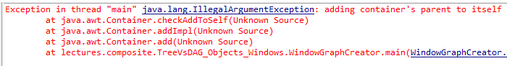
Window (Cyclic) Graph Creator
public static JFrame createTree {
JFrame frame = new JFrame();
JSplitPane splitPane = new JSplitPane();
frame.add(splitPane);
JPanel leftPanel = new JPanel();
JPanel rightPanel = new JPanel();
splitPane.setLeftComponent(leftPanel);
splitPane.setRightComponent(rightPanel);
JTextField textField = new JTextField("Edit me");
leftPanel.add(textField);
rightPanel.add(splitPane);
frame.setSize(200, 100);
frame.setVisible(true);
return frame;
}
JPanel
JTextField
JFrame
JSplitPane
JPanel

Slide 23
Window vs. Other Structures
Both are object structures that can be trees, DAGs and arbitrary Graphs
Window structures describe components of the user interface
Non window object structures we have seen are mapped to window structures by ObjectEditor
Some window structures are Beans
JSplitPane has fixed number of left and right component of with getters and setters
Some are collections
JPanel has dynamic number of components added by add()

Slide 24
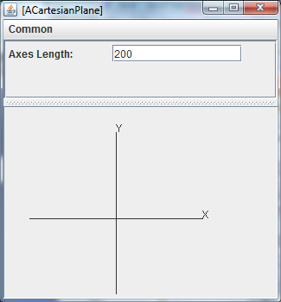
Window vs. Other Structures
ACartesianPlane Structure?
JFrame Structure

Slide 25
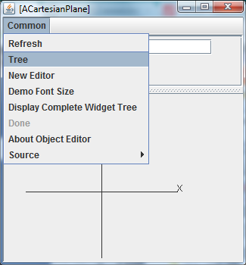
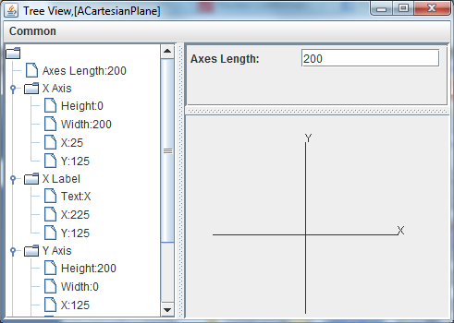
ACartesianPlane Structure

Slide 26
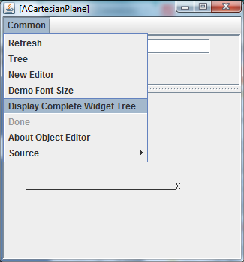
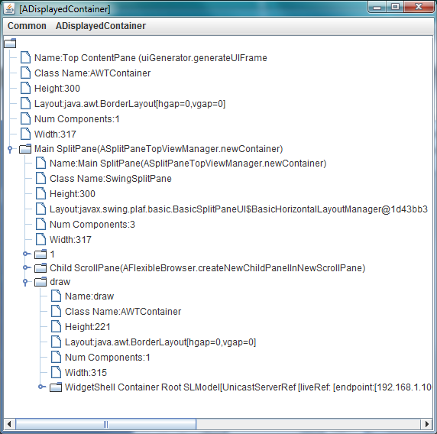
Window Structures

Slide 27
Object Editor
Automatically maps logical structure to window structure

Slide 28
Rest are extra

Slide 29
User Interface Structures
User interfaces are also structures; they consist of objects called windows or widgets or (UI) components
Root objects:
JFrame, Frame(top level window)
Leaf level objects:
JTextField, JButton, JSlider
Composite internal nodes:
JPanel – contains other UI components
JSplitPane – divides parent composite into two units with adjustable boundary

